Slide 1
机器人与人工智能实验室 Robotics and Artificial Intelligence Laboratory
WELCOME TO

Slide 2
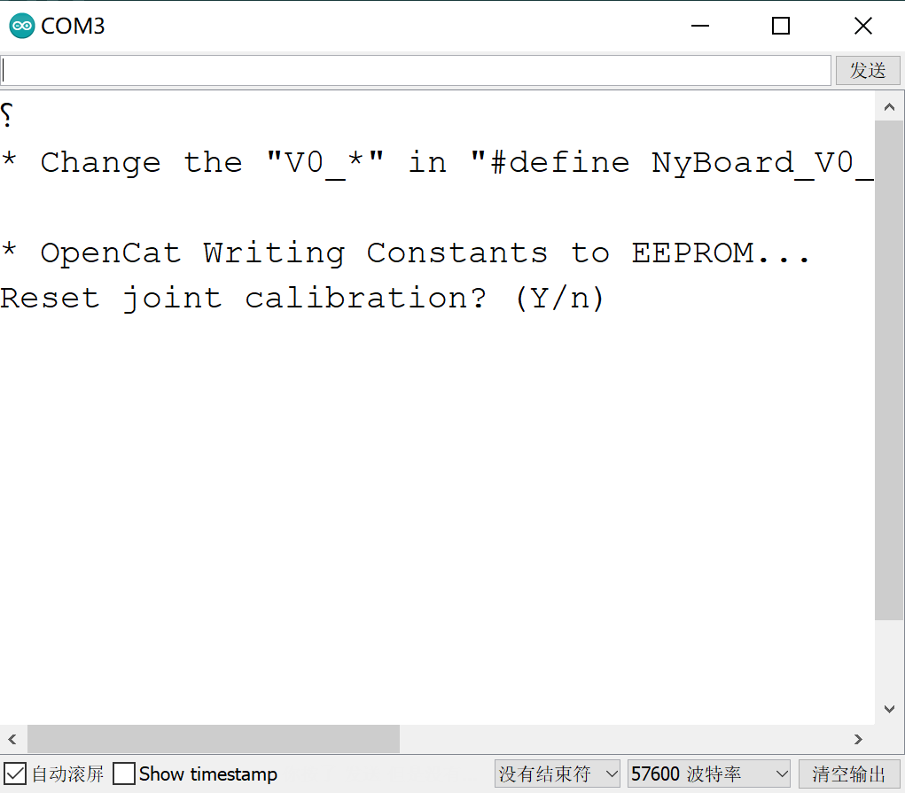
Tips on the Software
1. The Serial Monitor
Significant for updating instincts of the cat!
Choose “No Line Ending” but Not “New Line”

Slide 3
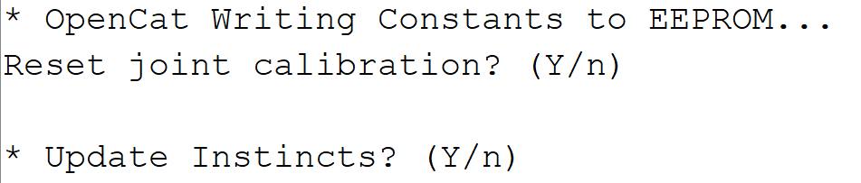
Tips on the Software
The Serial Monitor
Only if No Line Ending is selected will the window shows the prompt for updating instincts.

Slide 4

THANK YOU
林天麟 教授
香港中文大学（深圳）
机器人与人工智能实验室
WeChat: tinlunlam

